Slide 1

Code to Cloud Workshop
Introduction

Slide 2

WORKSHOP
8 hour | 4 | 58 | 64 | 510 GB
Total commitment over 4 days | Keynote Speakers | Participants | CPUs | RAM
SUCCESS

Slide 3
WORKSHOP AGENDA
DAY 1 | DAY 2 | DAY 3 | DAY 4
Package your website into a Docker container & Push it to cloud | Deploy your webiste to the cloud | <yourname>.workshop.nexjcloud.com | HTTPS Access the logs
Code 2 Cloud

Slide 4


IF THE COMMAND DOESN’T WORK…
Workshops will be recorded
Workshops will be recorded and made available right after each session.
Search online
Every challenge is unique. Please search online and share the solution with the team
Slack channel
Message on #training-code2cloud, if you can’t find the solution :)

Slide 5

KEY PERFORMANCE INDICATOR
Successful Knowledge Transfer
2 weeks
4 sessions
huge investment by our company.

Slide 6
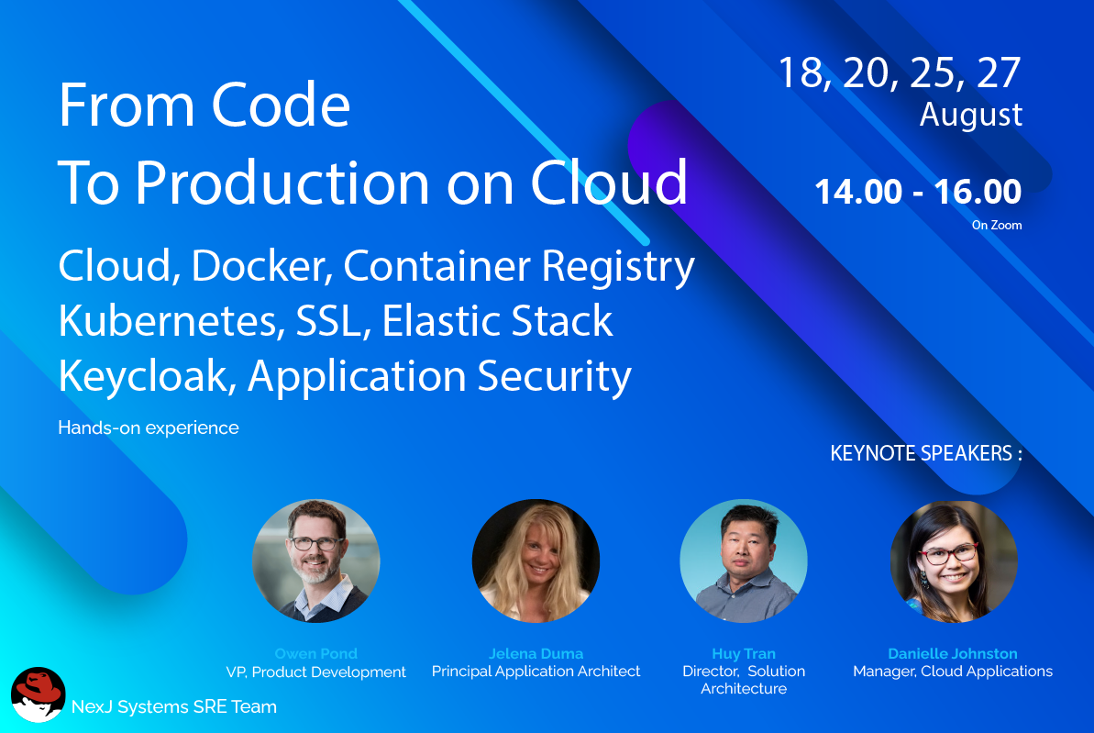
THANK YOU!
THANK YOU!

